Slide 1
COMP 2230
Week 6 - Friday

Slide 2
Last time
More set theory review
Russell's Paradox

Slide 3
Questions?

Slide 4
Assignment 3

Slide 5
Logical warmup
You have 15 bags
How many marbles do you need so that you can have a different number of marbles in each bag?

Slide 6
Halting Problem

Slide 7
Applying the idea again
It turns out that the idea behind Russell's Paradox has practical implications
It wasn't new, either
Cantor had previously used a diagonal argument to show that there are more real numbers than rational numbers
But, unexpectedly, Turing found an application of this idea for computing

Slide 8
Turing machine
A Turing machine is a mathematical model for computation
It consists of a head, an infinitely long tape, a set of possible states, and an alphabet of characters that can be written on the tape
A list of rules saying what it should write and should it move left or right given the current symbol and state
A
1 | 0 | 1 | 1 | 1 | 1 | 0 | 0 | 0 | 0

Slide 9
Church-Turing thesis
If an algorithm exists, a Turing machine can perform that algorithm
In essence, a Turing machine is the most powerful model we have of computation
Power, in this sense, means the ability to compute some function, not the speed associated with its computation

Slide 10
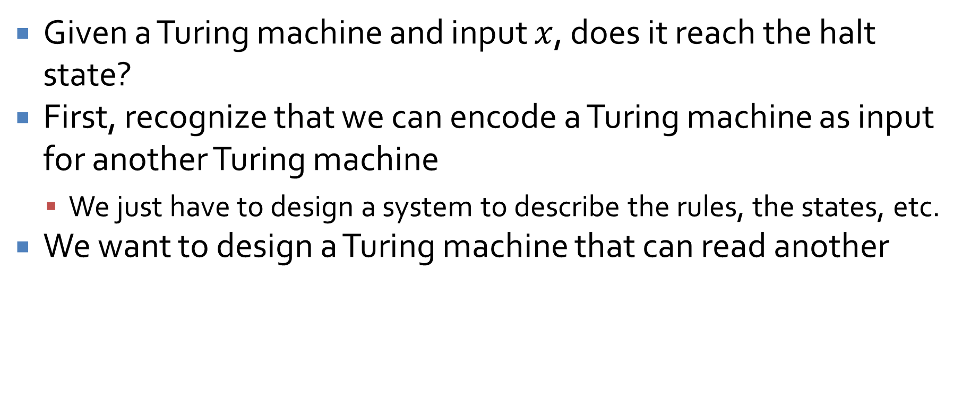
Halting problem
Given a Turing machine and input $x$, does it reach the halt state?
First, recognize that we can encode a Turing machine as input for another Turing machine
We just have to design a system to describe the rules, the states, etc.
We want to design a Turing machine that can read another

Slide 11
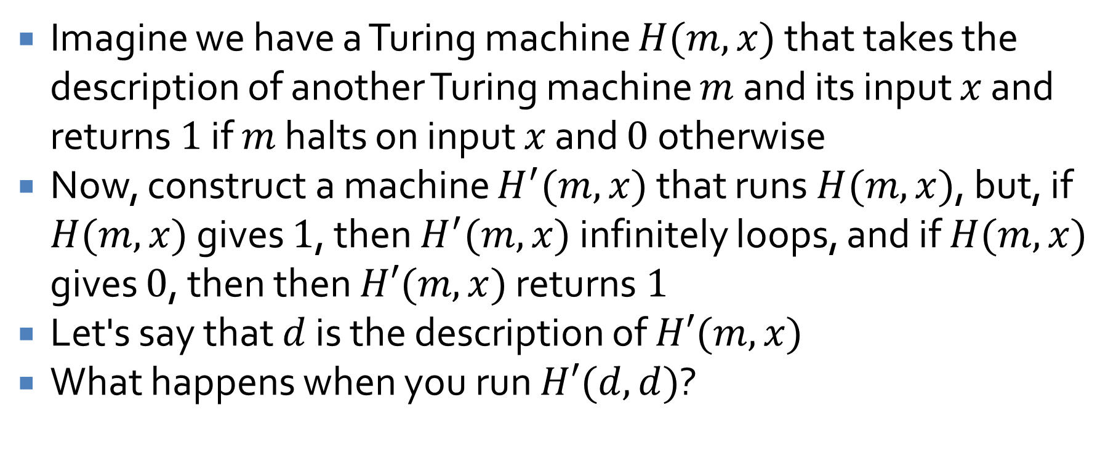
Halting problem problems
Imagine we have a Turing machine $H(m,x)$ that takes the description of another Turing machine $m$ and its input $x$ and returns $1$ if $m$ halts on input $x$ and $0$ otherwise
Now, construct a machine $H^{′}(m,x)$ that runs $H(m,x)$, but, if $H(m,x)$ gives $1$, then $H^{′}(m,x)$ infinitely loops, and if $H(m,x)$ gives $0$, then then $H′(m,x)$ returns $1$
Let's say that $d$ is the description of $H′(m,x)$
What happens when you run $H′(d,d)$?

Slide 12
Halting problem conclusion
Clearly, a Turing machine that solves the halting problem can't exist
Essentially, the problem of deciding if a problem is computable is itself uncomputable
Therefore, there are some problems (called undecidable) for which there is no algorithm
Not an algorithm that will take a long time, but no algorithm
If we find such a problem, we are stuck
… unless someone can invent a more powerful model of computation

Slide 13
And it gets worse!
Gödel used diagonalization again to prove that it is impossible to create a consistent set of axioms that can prove everything about the set of natural numbers
As a consequence, you can create a system that is complete but not consistent
Or you can create a system that is consistent but not complete
Either way, there are principles in math in general that are true but impossible to prove, at least with any given system
You might as well give up on math now

Slide 14
Cardinality

Slide 15
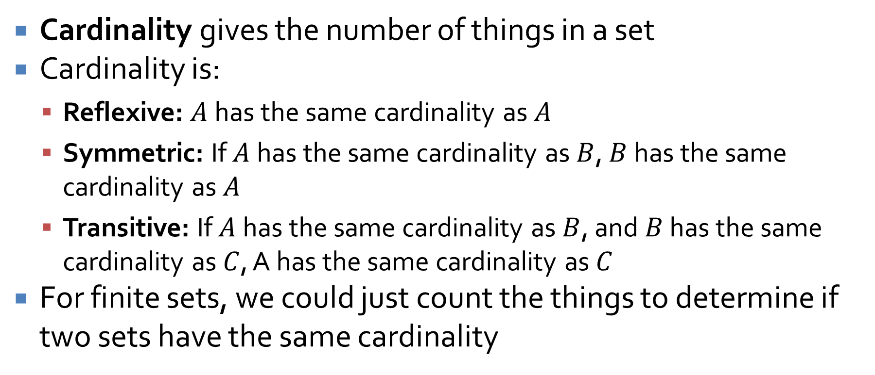
Cardinality
Cardinality gives the number of things in a set
Cardinality is:
Reflexive: $A$ has the same cardinality as $A$
Symmetric: If $A$ has the same cardinality as $B$, $B$ has the same cardinality as $A$
Transitive: If $A$ has the same cardinality as $B$, and $B$ has the same cardinality as $C$, A has the same cardinality as $C$
For finite sets, we could just count the things to determine if two sets have the same cardinality

Slide 16
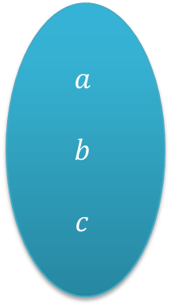

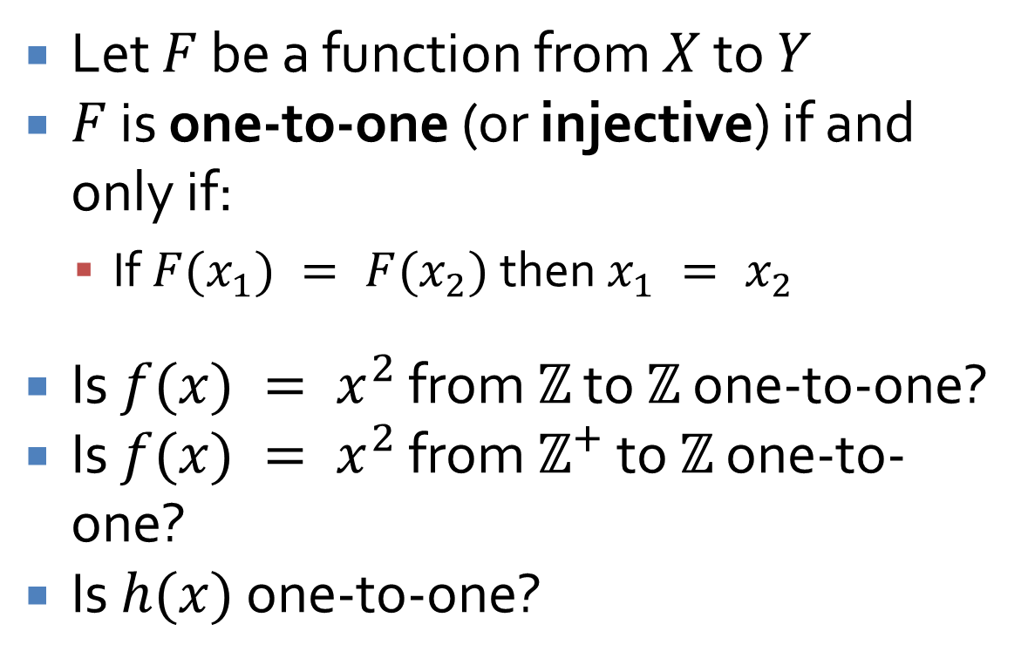


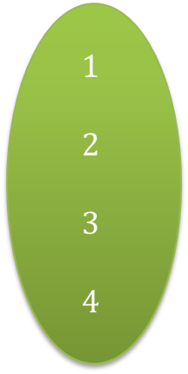
One-to-one functions
Let $F$ be a function from $X$ to $Y$
$F$ is one-to-one (or injective) if and only if:
If $F(x_{1}) = F(x_{2})$ then $x_{1} = x_{2}$
Is $f(x) = x^{2}$ from $ℤ$ to $ℤ$ one-to-one?
Is $f(x) = x^{2}$ from $ℤ^{+}$ to $ℤ$ one-to-one?
Is $h(x)$ one-to-one?
$$X$$
$$h$$
$$Y$$
$$a$$
$$b$$
$$c$$
$$1$$
$$2$$
$$3$$
$$4$$

Slide 17
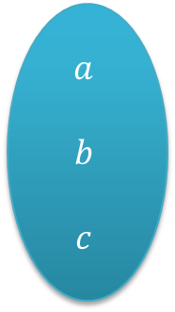

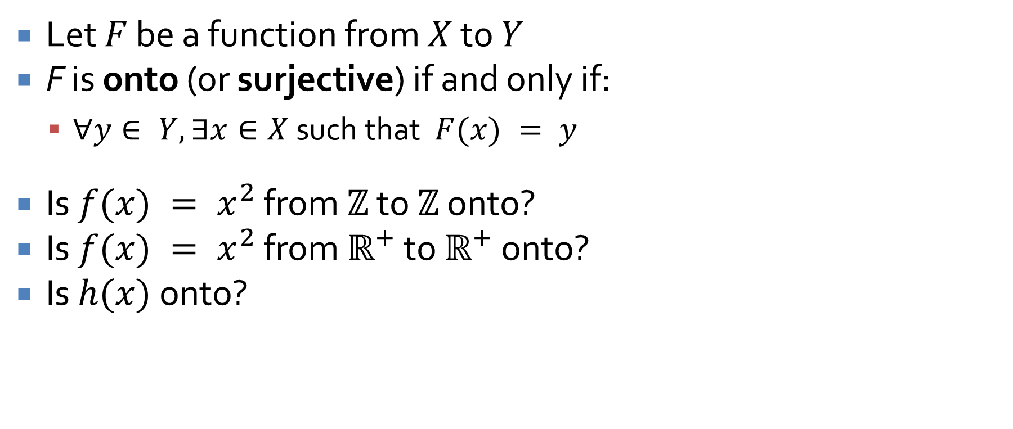


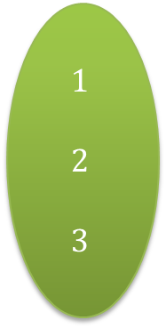
Onto functions
Let $F$ be a function from $X$ to $Y$
F is onto (or surjective) if and only if:
$∀y∈ Y, ∃x∈X$ such that $F(x) = y$
Is $f(x) = x^{2}$ from $ℤ$ to $ℤ$ onto?
Is $f(x) = x^{2}$ from $ℝ^{+}$ to $ℝ^{+}$ onto?
Is $h(x)$onto?
$$X$$
$$h$$
$$Y$$
$$a$$
$$b$$
$$c$$
$$1$$
$$2$$
$$3$$

Slide 18
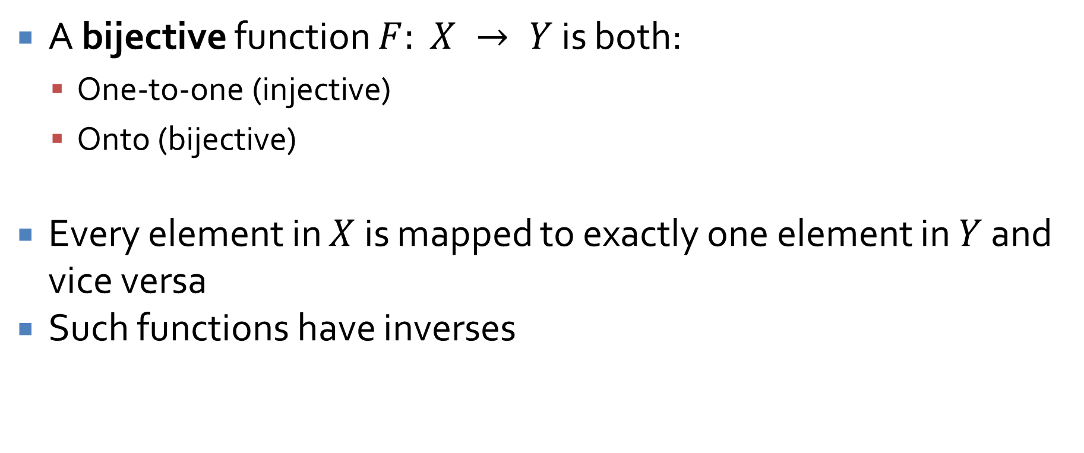
Bijective functions
A bijective function $F: X → Y$ is both:
One-to-one (injective)
Onto (bijective)
Every element in $X$ is mapped to exactly one element in $Y$ and vice versa
Such functions have inverses

Slide 19
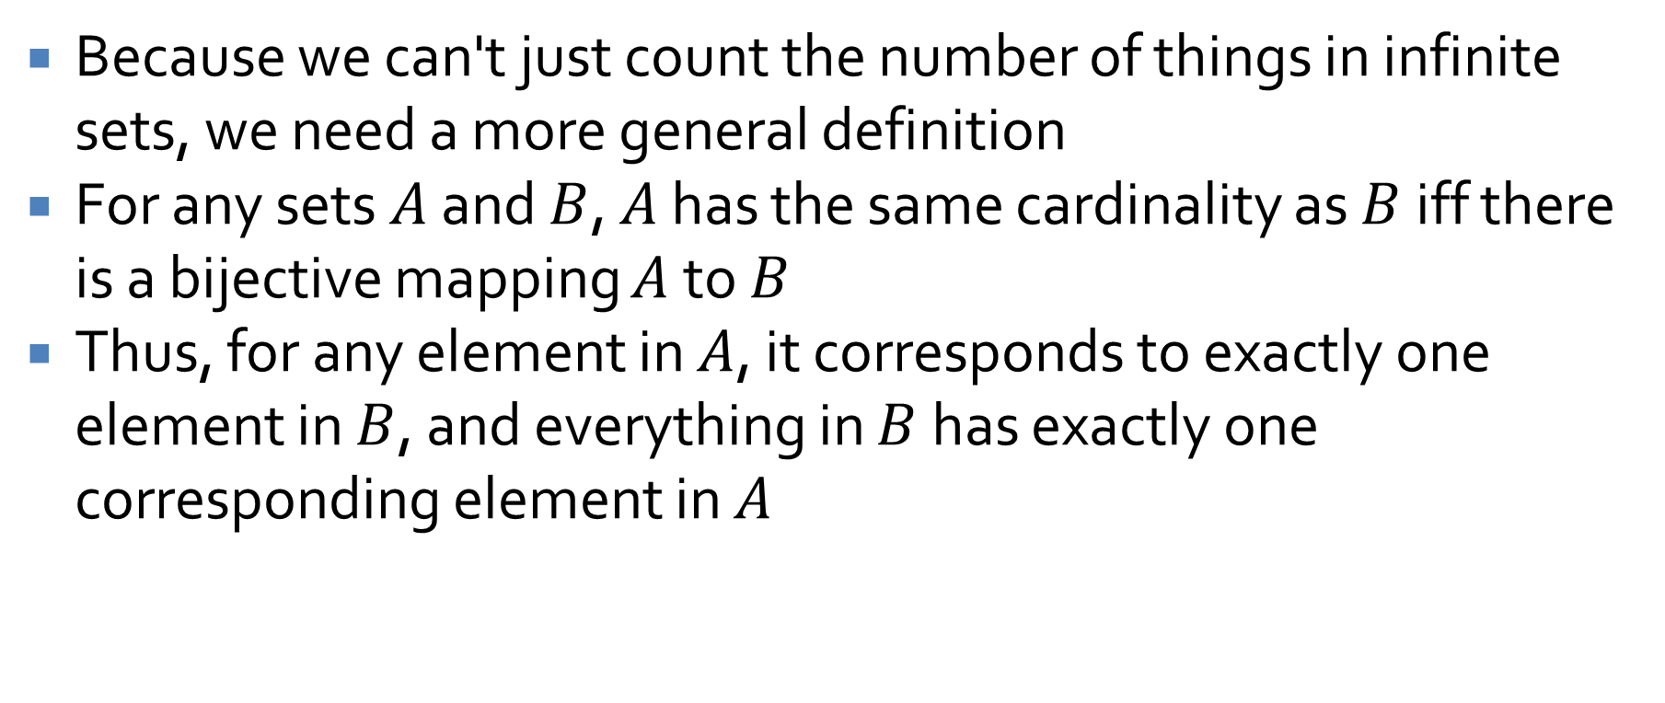
Cardinality for infinite sets
Because we can't just count the number of things in infinite sets, we need a more general definition
For any sets $A$ and $B$, $A$ has the same cardinality as $B$ iff there is a bijective mapping $A$ to $B$
Thus, for any element in $A$, it corresponds to exactly one element in $B$, and everything in $B$ has exactly one corresponding element in $A$

Slide 20
Cardinality example
Show that the set of positive integers has the same cardinality as the set of all integers
Hint: Create a bijective function from all integers to positive integers
Hint 2: Map the positive integers to even integers and the negative integers to odd integers

Slide 21
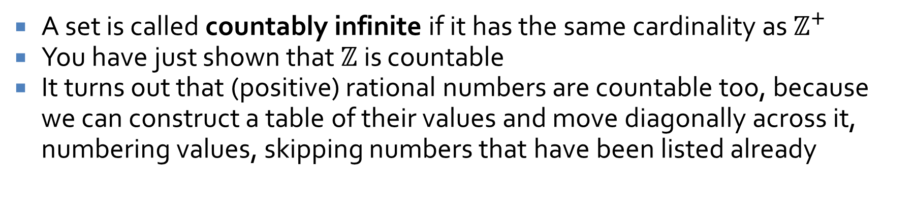
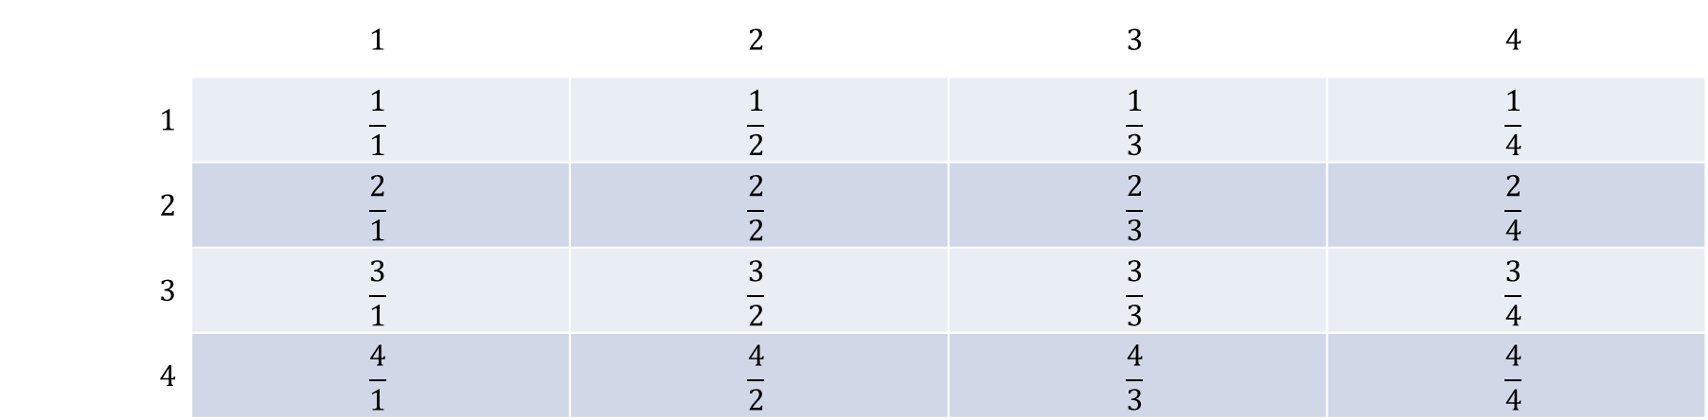
Countability
A set is called countably infinite if it has the same cardinality as $ℤ^{+}$
You have just shown that $ℤ$ is countable
It turns out that (positive) rational numbers are countable too, because we can construct a table of their values and move diagonally across it, numbering values, skipping numbers that have been listed already
 | $$1$$ | $$2$$ | $$3$$ | $$4$$
$$1$$ | $$\frac{1}{1}$$ | $$\frac{1}{2}$$ | $$\frac{1}{3}$$ | $$\frac{1}{4}$$
$$2$$ | $$\frac{2}{1}$$ | $$\frac{2}{2}$$ | $$\frac{2}{3}$$ | $$\frac{2}{4}$$
$$3$$ | $$\frac{3}{1}$$ | $$\frac{3}{2}$$ | $$\frac{3}{3}$$ | $$\frac{3}{4}$$
$$4$$ | $$\frac{4}{1}$$ | $$\frac{4}{2}$$ | $$\frac{4}{3}$$ | $$\frac{4}{4}$$

Slide 22
Uncountability
So if the number of integers is the same as the number of rational numbers, that must also be the same as the number of real numbers, right?
Wrong.
There are a lot more real numbers
The number of real numbers is called uncountable
It's a larger infinity than the number of integers
But it's not the largest infinity …
There is no largest infinity

Slide 23
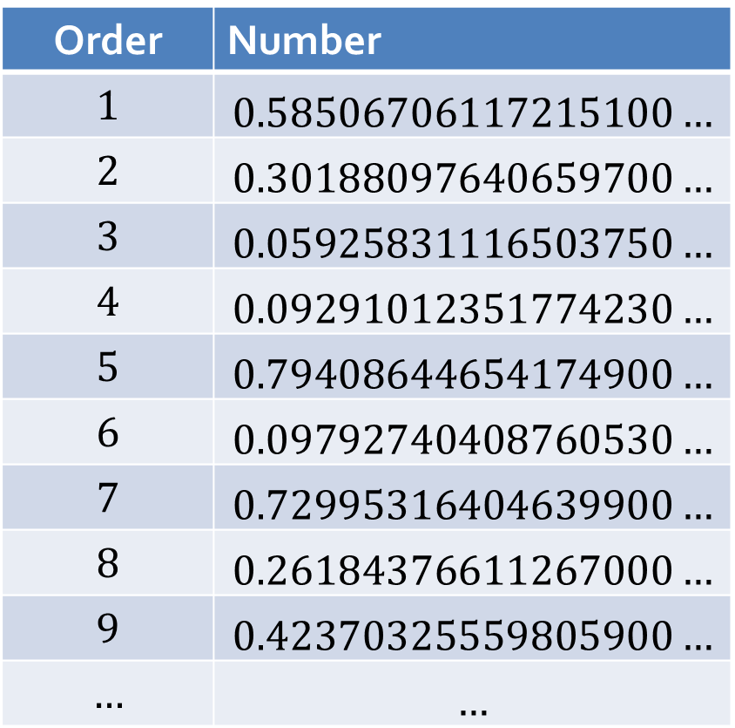
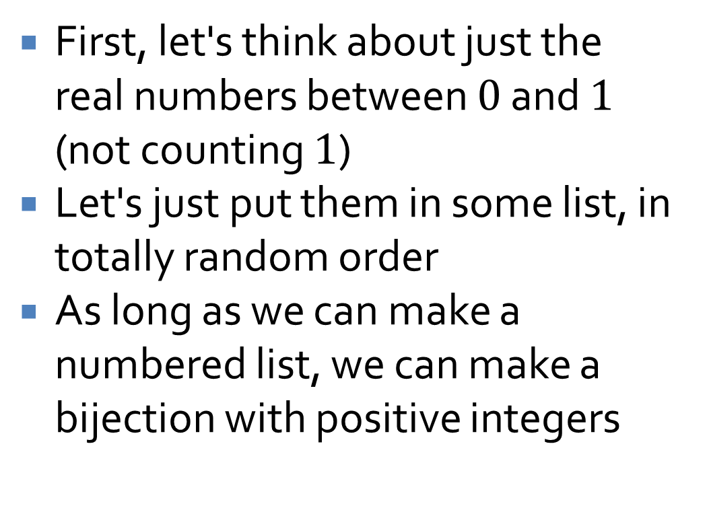
Proving that there are more real numbers
First, let's think about just the real numbers between $0$ and $1$ (not counting $1$)
Let's just put them in some list, in totally random order
As long as we can make a numbered list, we can make a bijection with positive integers
Order | Number
$$1$$ | $$0.58506706117215100…$$
$$2$$ | $$0.30188097640659700…$$
$$3$$ | $$0.05925831116503750…$$
$$4$$ | $$0.09291012351774230…$$
$$5$$ | $$0.79408644654174900…$$
$$6$$ | $$0.09792740408760530…$$
$$7$$ | $$0.72995316404639900…$$
$$8$$ | $$0.26184376611267000…$$
$$9$$ | $$0.42370325559805900…$$
$$…$$ | $$…$$

Slide 24
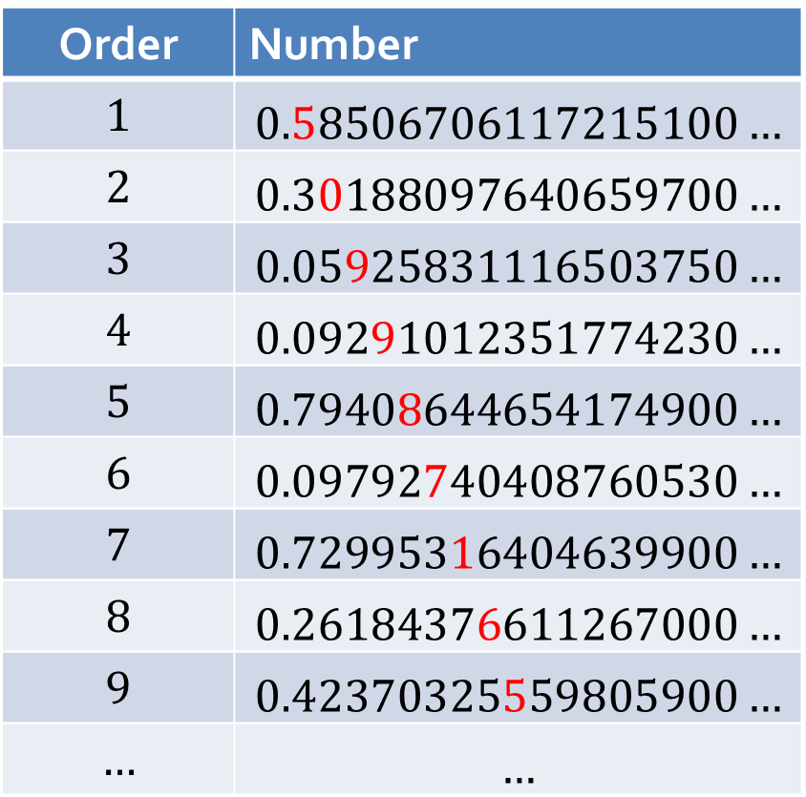
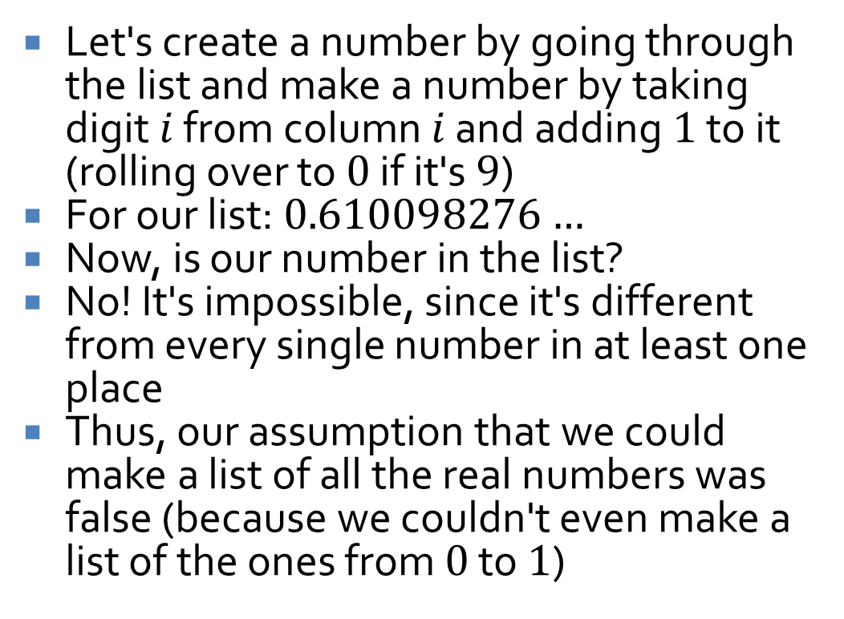
Proof continued
Let's create a number by going through the list and make a number by taking digit $i$ from column $i$ and adding $1$ to it (rolling over to $0$ if it's $9$)
For our list: $0.610098276…$
Now, is our number in the list?
No! It's impossible, since it's different from every single number in at least one place
Thus, our assumption that we could make a list of all the real numbers was false (because we couldn't even make a list of the ones from $0$ to $1$)
Order | Number
$$1$$ | $$0.58506706117215100…$$
$$2$$ | $$0.30188097640659700…$$
$$3$$ | $$0.05925831116503750…$$
$$4$$ | $$0.09291012351774230…$$
$$5$$ | $$0.79408644654174900…$$
$$6$$ | $$0.09792740408760530…$$
$$7$$ | $$0.72995316404639900…$$
$$8$$ | $$0.26184376611267000…$$
$$9$$ | $$0.42370325559805900…$$
$$…$$ | $$…$$

Slide 25
Names
For future reference, the cardinality of positive integers, countable infinity, is named ℵ₀ (pronounced aleph null)
The cardinality of real numbers, the first uncountable infinity (because there are infinitely many uncountable infinities), is named ℵ₁ (pronounced aleph 1)

Slide 26
Relations

Slide 27
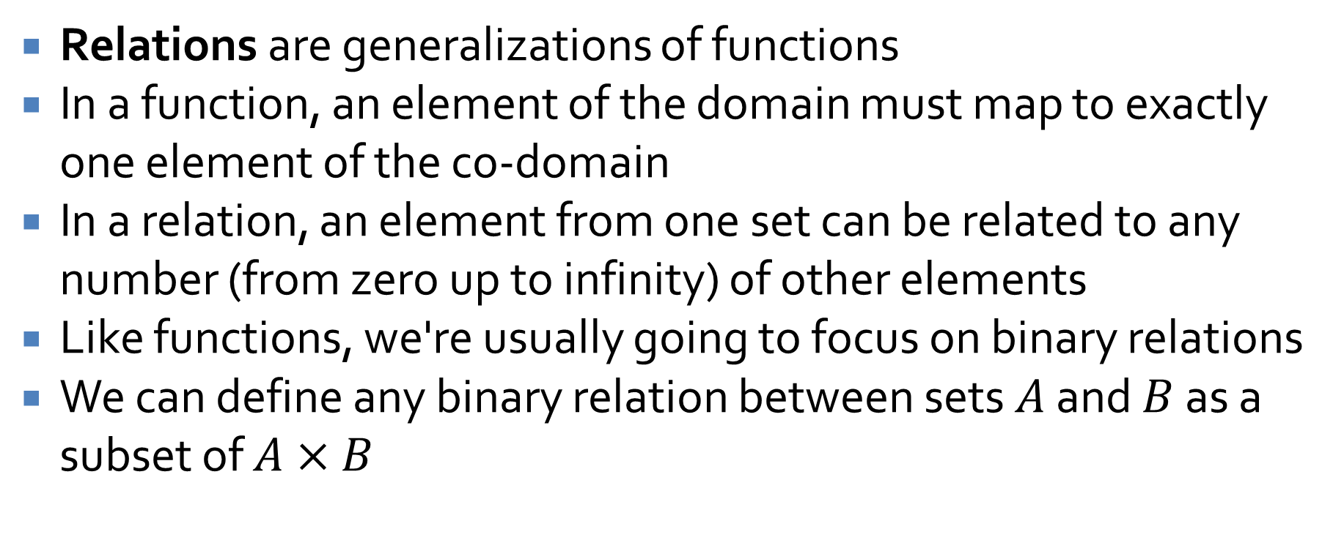
Relations
Relations are generalizations of functions
In a function, an element of the domain must map to exactly one element of the co-domain
In a relation, an element from one set can be related to any number (from zero up to infinity) of other elements
Like functions, we're usually going to focus on binary relations
We can define any binary relation between sets $A$ and $B$ as a subset of $A×B$

Slide 28
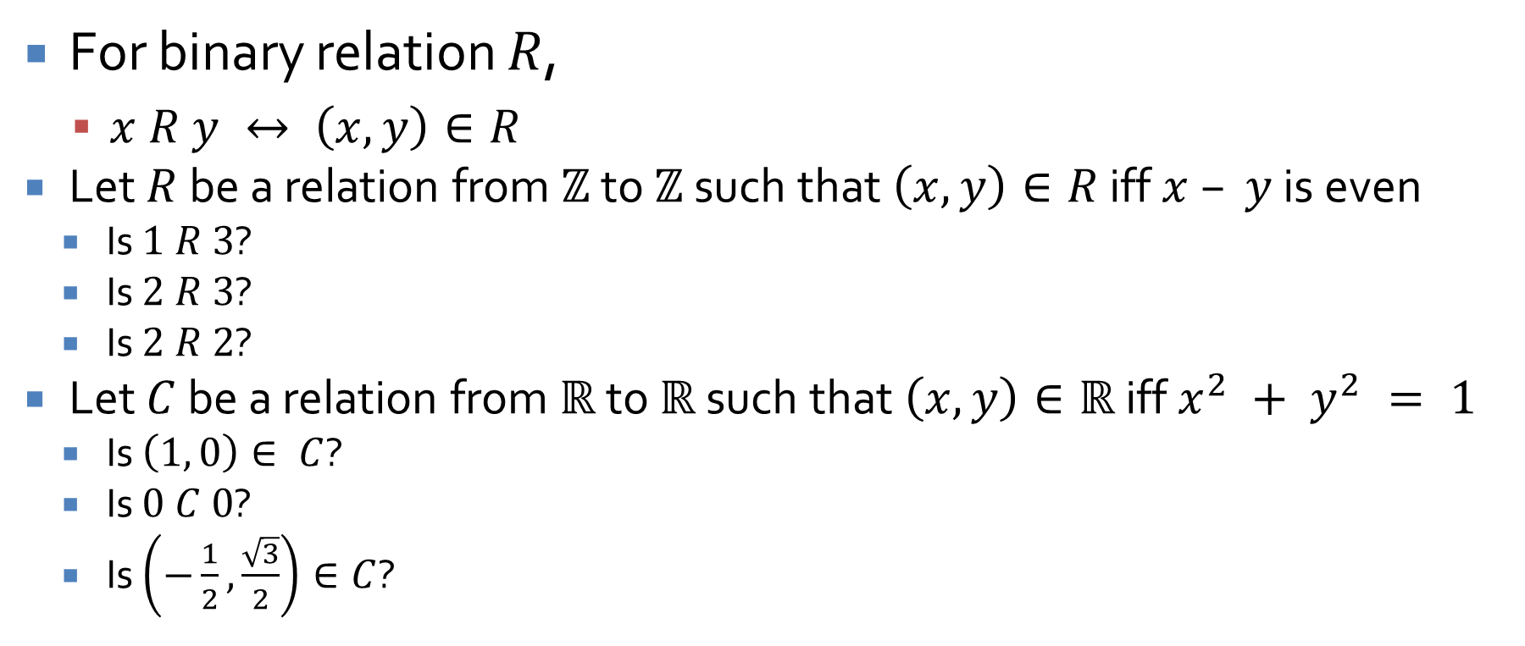
Notation
For binary relation $R$,
$x R y ↔ \left(x, y\right)∈R$
Let $R$ be a relation from $ℤ$ to $ℤ$ such that $\left(x, y\right)∈R$ iff $x – y$ is even
Is $1 R 3$?
Is $2 R 3$?
Is $2 R 2$?
Let $C$ be a relation from $ℝ$ to $ℝ$ such that $\left(x, y\right)∈ℝ$ iff $x^{2} + y^{2} = 1$
Is $\left(1, 0\right)∈ C$?
Is $0 C 0$?
Is $\left(−\frac{1}{2},\frac{\sqrt{3}}{2}\right)∈C$?

Slide 29
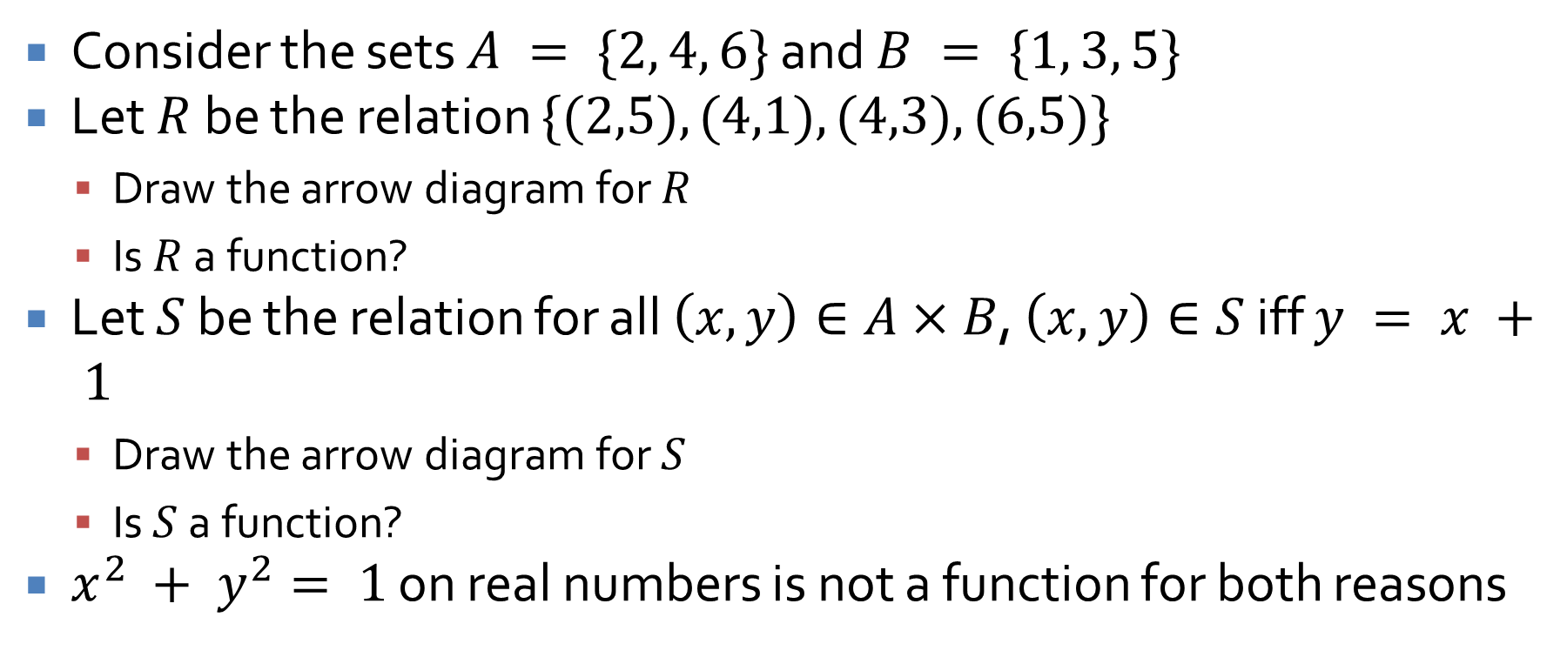
Function or not?
Consider the sets $A = \{2, 4, 6\}$ and $B = \{1, 3, 5\}$
Let $R$ be the relation $\{(2,5), (4,1), (4,3), (6,5)\}$
Draw the arrow diagram for $R$
Is $R$ a function?
Let $S$ be the relation for all $\left(x, y\right)∈A×B$, $\left(x, y\right)∈S$ iff $y = x + 1$
Draw the arrow diagram for $S$
Is $S$ a function?
$x^{2} + y^{2}= 1$ on real numbers is not a function for both reasons

Slide 30
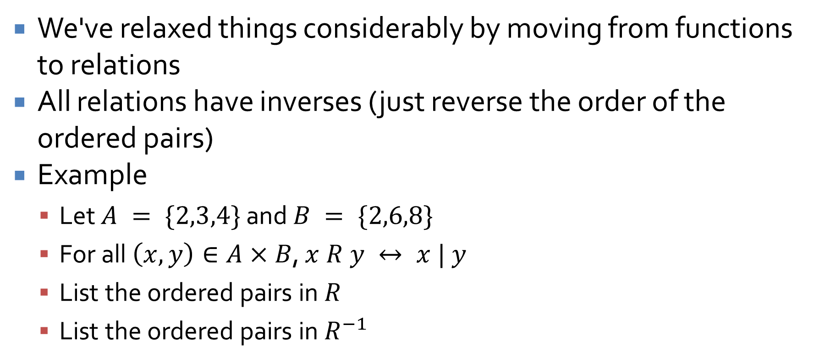
Inverses
We've relaxed things considerably by moving from functions to relations
All relations have inverses (just reverse the order of the ordered pairs)
Example
Let $A = \{2,3,4\}$ and $B = \{2,6,8\}$
For all $\left(x, y\right)∈A×B$, $x R y ↔ x | y$
List the ordered pairs in $R$
List the ordered pairs in $R^{−1}$

Slide 31
Directed graphs
A directed graph describes a relationship between nodes
One way to record a graph is as a matrix
We can also think of a directed graph as a relation from a set to itself
What's the relation for this directed graph?
a
b
c
d
e

Slide 32
Upcoming

Slide 33
Next time…
Reflexivity
Symmetry
Transitivity
Equivalence relations

Slide 34
Reminders
Work on Assignment 3
Due next Friday
Read 8.2 and 8.3

